Slide 1
GATE-LEVEL MODELING
A design at a low level of abstraction gate level
Most digital design is now done at gate level or higher levels of abstraction
At gate level, the circuit is described in terms of gates (e.g., and, nand)
Hardware design at this level is intuitive for a user with a basic knowledge of digital logic design because it is possible to see a one-to-one correspondence between the logic circuit diagram and the Verilog description
Actually, the lowest level of abstraction is switch- (transistor-) level modeling
However, with designs getting very complex, very few hardware designers work at switch level

Slide 2
GATE-LEVEL MODELING - LEARNING OBJECTIVES
Identify logic gate primitives provided in Verilog
Understand instantiation of gates, gate symbols, and truth tables for and/or and buf/not type gates
Understand how to construct a Verilog description from the logic diagram of the circuit
Describe rise, fall, and turn-off delays in the gate-level design
Explain min, max, and typ delays in the gate-level design

Slide 3
GATE TYPES
A logic circuit can be designed by use of logic gates
Verilog supports basic logic gates as predefined primitives
These primitives are instantiated like modules except that they are predefined in Verilog and do not need a module definition
All logic circuits can be designed by using basic gates
There are two classes of basic gates:
and/or gates and
buf/not gates

Slide 4
And/Or Gates
And/or gates have one scalar output and multiple scalar inputs
The first terminal in the list of gate terminals is an output and the other terminals are inputs
The output of a gate is evaluated as soon as one of the inputs changes
The and/or gates available in Verilog are shown below
and or xor
nand nor xnor

Slide 5
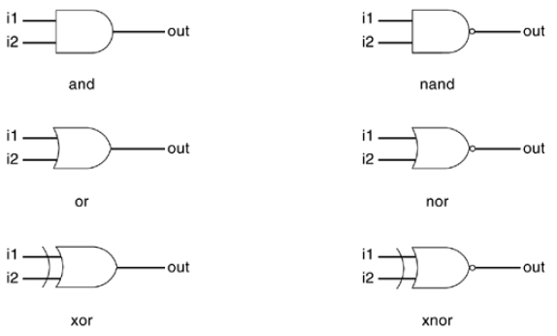
And/Or Gates –Cont’d
Figure 1. Basic Gates
We consider gates with two inputs. The output terminal is denoted by out. Input terminals are denoted by i1 and i2

Slide 6
Example 1: Gate Instantiation of And/Or Gates
wire OUT, IN1, IN2;
// basic gate instantiations.
and a1(OUT, IN1, IN2);
nand na1(OUT, IN1, IN2);
or or1(OUT, IN1, IN2);
nor nor1(OUT, IN1, IN2);
xor x1(OUT, IN1, IN2);
xnor nx1(OUT, IN1, IN2);
// More than two inputs; 3 input nand gate
nand na1_3inp(OUT, IN1, IN2, IN3);
// gate instantiation without instance name
and (OUT, IN1, IN2); // legal gate instantiation

Slide 7
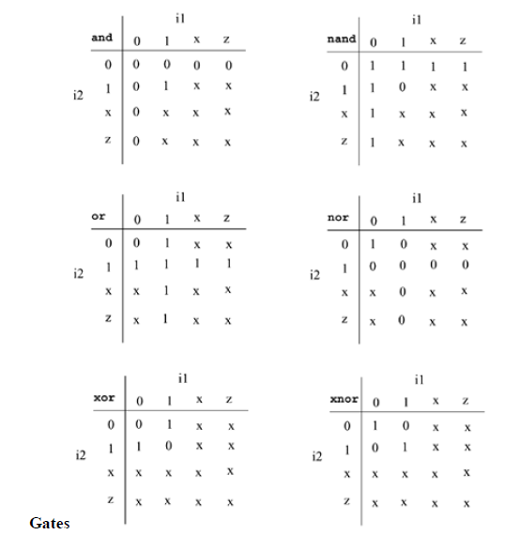
TRUTH TABLES FOR THESE GATES
The truth tables for these gates define how outputs for the gates are computed from the inputs
Truth tables are defined assuming two inputs
Outputs of gates with more than two inputs are computed by applying the truth table iteratively
Table 1. Truth Tables for And/Or

Slide 8
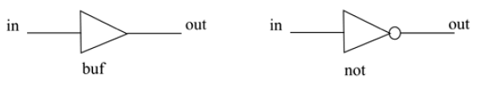
Buf/Not Gates
Buf/not gates have one scalar input and one or more scalar outputs
The last terminal in the port list is connected to the input. Other terminals are connected to the outputs
Two basic buf/not gate primitives are provided in Verilog
buf not

Slide 9
Example 2: Gate Instantiations of Buf/Not Gates
// basic gate instantiations.
buf b1(OUT1, IN);
not n1(OUT1, IN);
// More than two outputs
buf b1_2out(OUT1, OUT2, IN);
// gate instantiation without instance name
not (OUT1, IN); // legal gate instantiation

Slide 10
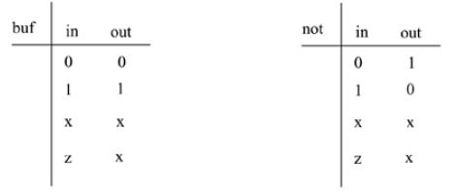
Truth Tables for Buf/Not Gates
Table 2. Truth Tables for Buf/Not Gates

Slide 11
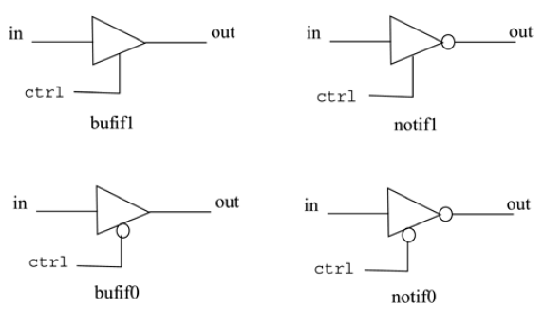
Gates with an additional control signal on buf and not gates
Bufif/notif
bufif1 notif1
bufif0 notif0
These gates are used when a signal is to be driven only when the control signal is asserted
Such a situation is applicable when multiple drivers drive the signal
Figure 3. Gates Bufif and Notif
These gates propagate only if their control signal is asserted
They propagate z if their control signal is deasserted
Symbols for bufif/notif are shown in Figure 3

Slide 12
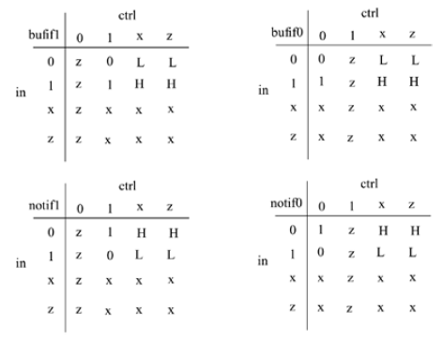
Truth Tables for Bufif/Notif Gates
Table 3. Truth Tables for Bufif/Notif Gates

Slide 13
Example 3: Gate Instantiations of Bufif/Notif Gates
These drivers are designed to drive the signal on mutually exclusive control signals.
Example 3 shows examples of instantiation of bufif and notif gates.
Example 3 Gate Instantiations of Bufif/Notif Gates
//Instantiation of bufif gates.
bufif1 b1 (out, in, ctrl);
bufif0 b0 (out, in, ctrl);
//Instantiation of notif gates
notif1 n1 (out, in, ctrl);
notif0 n0 (out, in, ctrl);

Slide 14
Array of Instances
There are many situations when repetitive instances are required
These instances differ from each other only by the index of the vector to which they are connected
To simplify specification of such instances, Verilog HDL allows an array of primitive instances to be defined
Example 4 shows an example of an array of instances

Slide 15
Example 4: Simple Array of Primitive Instances
Example 4 Simple Array of Primitive Instances
wire [7:0] OUT, IN1, IN2;
// basic gate instantiations.
nand n_gate[7:0](OUT, IN1, IN2);
// This is equivalent to the following 8 instantiations
nand n_gate0(OUT[0], IN1[0], IN2[0]);
nand n_gate1(OUT[1], IN1[1], IN2[1]);
nand n_gate2(OUT[2], IN1[2], IN2[2]);
nand n_gate3(OUT[3], IN1[3], IN2[3]);
nand n_gate4(OUT[4], IN1[4], IN2[4]);
nand n_gate5(OUT[5], IN1[5], IN2[5]);
nand n_gate6(OUT[6], IN1[6], IN2[6]);
nand n_gate7(OUT[7], IN1[7], IN2[7]);

Slide 16
Gate-level multiplexer
We will design a 4-to-1 multiplexer with 2 select signals
Multiplexers serve a useful purpose in logic design
They can connect two or more sources to a single destination
They can also be used to implement boolean functions
We will assume for this example that signals s1 and s0 do not get the value x or z
The I/O diagram and the truth table for the multiplexer are shown in Figure 4
The I/O diagram will be useful in setting up the port list for the multiplexer

Slide 17
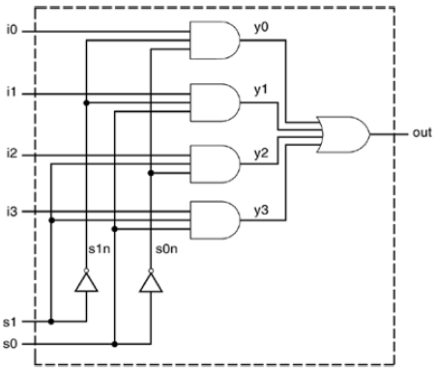
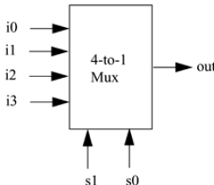
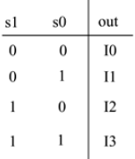
Gate-level multiplexer –Cont’d
Figure 5. Logic Diagram for Multiplexer
Figure 4. 4-to-1 Multiplexer

Slide 18
Gate-level multiplexer –Cont’d
The logic diagram has a one-to-one correspondence with the Verilog description
The Verilog description for the multiplexer is shown in Example 5
Two intermediate nets, s0n and s1n, are created; they are complements of input signals s1 and s0
Internal nets y0, y1, y2, y3 are also required
Note that instance names are not specified for primitive gates, not, and, and or
Instance names are optional for Verilog primitives but are mandatory for instances of user-defined modules

Slide 19
Example 5.1: Verilog Description of Multiplexer
// Gate instantiations
// Create s1n and s0n signals.
not (s1n, s1);
not (s0n, s0);
// 3-input and gates instantiated
and (y0, i0, s1n, s0n);
and (y1, i1, s1n, s0);
and (y2, i2, s1, s0n);
and (y3, i3, s1, s0);
// 4-input or gate instantiated
or (out, y0, y1, y2, y3);
endmodule
// Module 4-to-1 multiplexer. Port list is taken exactly from the I/O diagram.
module mux4_to_1 (out, i0, i1, i2, i3, s1, s0);
// Port declarations from the I/O diagram
output out;
input i0, i1, i2, i3;
input s1, s0;
// Internal wire declarations
wire s1n, s0n;
wire y0, y1, y2, y3;

Slide 20
Example 5.2 Stimulus for Multiplexer
// Define the stimulus module (no ports)
module stimulus;
// Declare variables to be connected
// to inputs
reg IN0, IN1, IN2, IN3;
reg S1, S0;
// Declare output wire
wire OUTPUT;
// Instantiate the multiplexer
mux4_to_1 mymux(OUTPUT, IN0, IN1, IN2, IN3, S1, S0);

Slide 21
Example 5.2 Stimulus for Multiplexer –Cont’d
// Stimulate the inputs
// Define the stimulus module (no ports)
initial
begin
// set input lines
IN0 = 1; IN1 = 0; IN2 = 1; IN3 = 0;
#1 $display("IN0= %b, IN1= %b, IN2= %b, IN3= %b\n",IN0,IN1,IN2,IN3);
// choose IN0
S1 = 0; S0 = 0;
#1 $display("S1 = %b, S0 = %b, OUTPUT = %b \n", S1, S0, OUTPUT);
// choose IN1
S1 = 0; S0 = 1;
#1 $display("S1 = %b, S0 = %b, OUTPUT = %b \n", S1, S0, OUTPUT);

Slide 22
Example 5.2 Stimulus for Multiplexer –Cont’d
// choose IN2
S1 = 1; S0 = 0;
#1 $display("S1 = %b, S0 = %b, OUTPUT = %b \n", S1, S0, OUTPUT);
// choose IN3
S1 = 1; S0 = 1;
#1 $display("S1 = %b, S0 = %b, OUTPUT = %b \n", S1, S0, OUTPUT);
end
endmodule

Slide 23
Example 5.2 Stimulus for Multiplexer –Cont’d
The output of the simulation is shown below
Each combination of the select signals is tested
IN0= 1, IN1= 0, IN2= 1, IN3= 0
S1 = 0, S0 = 0, OUTPUT = 1
S1 = 0, S0 = 1, OUTPUT = 0
S1 = 1, S0 = 0, OUTPUT = 1
S1 = 1, S0 = 1, OUTPUT = 0

Slide 24

4-BIT RIPPLE CARRY FULL ADDER
In this example, we design a 4-bit full adder
We use primitive logic gates, and we apply stimulus to the 4-bit full adder to check functionality
For the sake of simplicity, we will implement a ripple carry adder
The basic building block is a 1-bit full adder
The mathematical equations for a 1-bit full adder are shown below

Slide 25
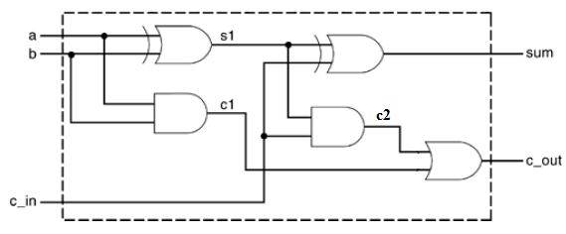
Example 7: Verilog Description for 1-bit Full Adder
// Define a 1-bit full adder
module fulladd(sum, c_out, a, b, c_in);
// I/O port declarations
output sum, c_out;
input a, b, c_in;
// Internal nets
wire s1, c1, c2;
// Instantiate logic gate primitives
xor (s1, a, b);
and (c1, a, b);
xor (sum, s1, c_in);
and (c2, s1, c_in);
or (c_out, c2, c1);
endmodule
Figure 6. 1-bit Full Adder

Slide 26
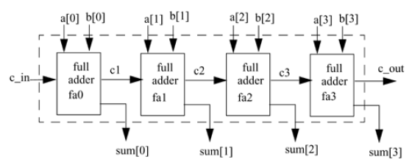
A 4-BIT RIPPLE CARRY FULL ADDER CONSTRUCTED FROM FOUR 1-BIT FULL ADDERS
Figure 7. 4-bit Ripple Carry Full Adder

Slide 27
A 4-BIT RIPPLE CARRY FULL ADDER CONSTRUCTED FROM FOUR 1-BIT FULL ADDERS –Cont’d
This structure can be translated to Verilog as shown in Example 8.1
Note that the port names used in a 1-bit full adder and a 4-bit full adder are the same but they represent different elements.
The element sum in a 1-bit adder is a scalar quantity and the element sum in the 4-bit full adder is a 4-bit vector quantity
Verilog keeps names local to a module. Names are not visible outside the module unless hierarchical name referencing is used
Also note that instance names must be specified when defined modules are instantiated, but when instantiating Verilog primitives, the instance names are optional

Slide 28
EXAMPLE 8.1: VERILOG DESCRIPTION FOR 4-BIT RIPPLE CARRY FULL ADDER
// Define a 4-bit full adder
module fulladd4(sum, c_out, a, b, c_in);
// I/O port declarations
output [3:0] sum;
output c_out;
input[3:0] a, b;
input c_in;
// Internal nets
wire c1, c2, c3;
// Instantiate four 1-bit full adders.
fulladd fa0(sum[0], c1, a[0], b[0], c_in);
fulladd fa1(sum[1], c2, a[1], b[1], c1);
fulladd fa2(sum[2], c3, a[2], b[2], c2);
fulladd fa3(sum[3], c_out, a[3], b[3], c3);
endmodule

Slide 29
Example 8.2 Stimulus for 4-bit Ripple Carry Full Adder
// Define the stimulus (top level module)
module stimulus;
// Set up variables
reg [3:0] A, B;
reg C_IN;
wire [3:0] SUM;
wire C_OUT;
// Instantiate the 4-bit full adder. call it FA1_4
fulladd4 FA1_4(SUM, C_OUT, A, B, C_IN);
// Set up the monitoring for the signal values
initial
begin
$monitor($time," A= %b, B=%b, C_IN= %b, --- C_OUT= %b, SUM= %b\n", A, B, C_IN, C_OUT, SUM);
end
// Stimulate inputs
initial
begin
A = 4'd0; B = 4'd0; C_IN = 1'b0;
#5 A = 4'd3; B = 4'd4;
#5 A = 4'd2; B = 4'd5;
#5 A = 4'd9; B = 4'd9;
#5 A = 4'd10; B = 4'd15;
#5 A = 4'd10; B = 4'd5; C_IN = 1'b1;
end
endmodule

Slide 30
Example 8.2 Stimulus for 4-bit Ripple Carry Full Adder –Cont’d
The output of the simulation is shown below
0 A= 0000, B=0000, C_IN= 0, --- C_OUT= 0, SUM= 0000
5 A= 0011, B=0100, C_IN= 0, --- C_OUT= 0, SUM= 0111
10 A= 0010, B=0101, C_IN= 0, --- C_OUT= 0, SUM= 0111
15 A= 1001, B=1001, C_IN= 0, --- C_OUT= 1, SUM= 0010
20 A= 1010, B=1111, C_IN= 0, --- C_OUT= 1, SUM= 1001
25 A= 1010, B=0101, C_IN= 1,, C_OUT= 1, SUM= 0000

